Slide 1
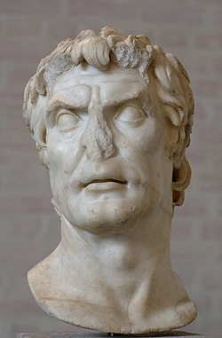
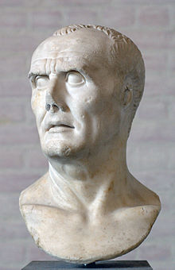
REVISION 3
EST PREPARATION
Week 4, Lesson 3

Slide 2
EST REVISION - Overview
WEEK | Tuesday | Wednesday | Thursday | Friday
3 | X | X | X | Revision 1
4 | Revision 2 | Revision 3 | Revision 4 | Revision 5
5 | EST | Inquiry | Inquiry | Inquiry
6 | Inquiry | Inquiry | Inquiry | Inquiry

Slide 3
Today’s Lesson
Source Analysis Question 3
Source Analysis Question 4

Slide 4
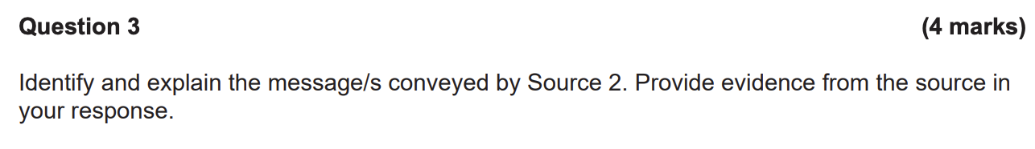
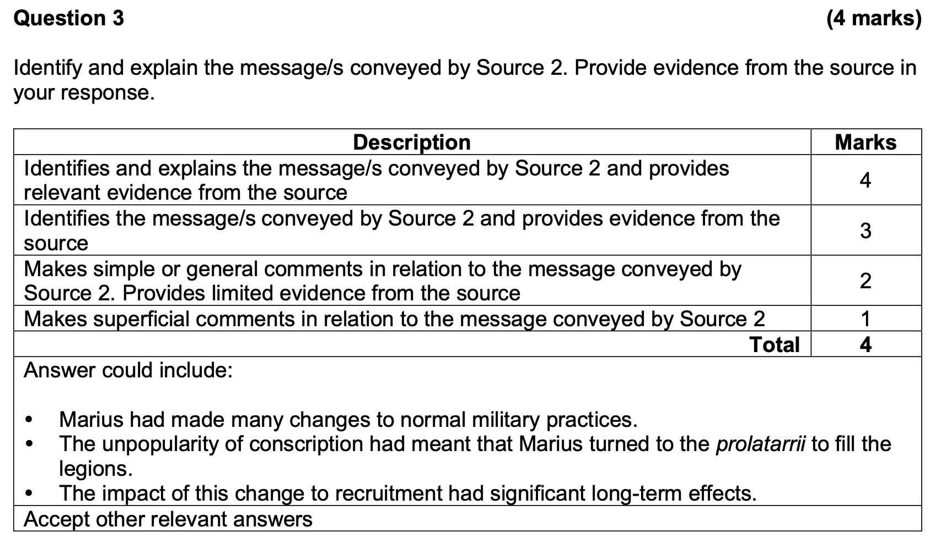
Question 3

Slide 5
Question 3 – How to answer
The message of Source _______ is ___________________________________ .
EXPLAIN the message.
Give EVIDENCE from the source.
Identifying the message involves you summarizing what the source is trying to say, without listing everything that is in the source. You just need to create a one-sentence “snapshot”

Slide 6
Example – Edit/Feedback:
The message of the source is about Sulla.
He was a bad guy with bad personal hygiene. He was not a lad and he dogged the boys. This can be seen in the source by where it says “he was a difficult military leader”. This shows that he was brutal and rude to others.

Slide 7
Example – Edit/Feedback:
The message of the Source is that Marius implemented many significant reforms which led to changes to ‘traditional’ military practices. The unpopularity of conscription had meant that Marius “turned to the prolatarrii to fill the legions”. The impact of this change to recruitment had significant long-term effects.

Slide 8
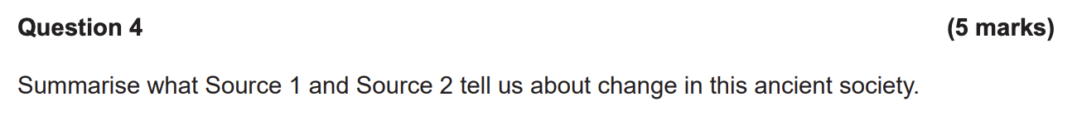
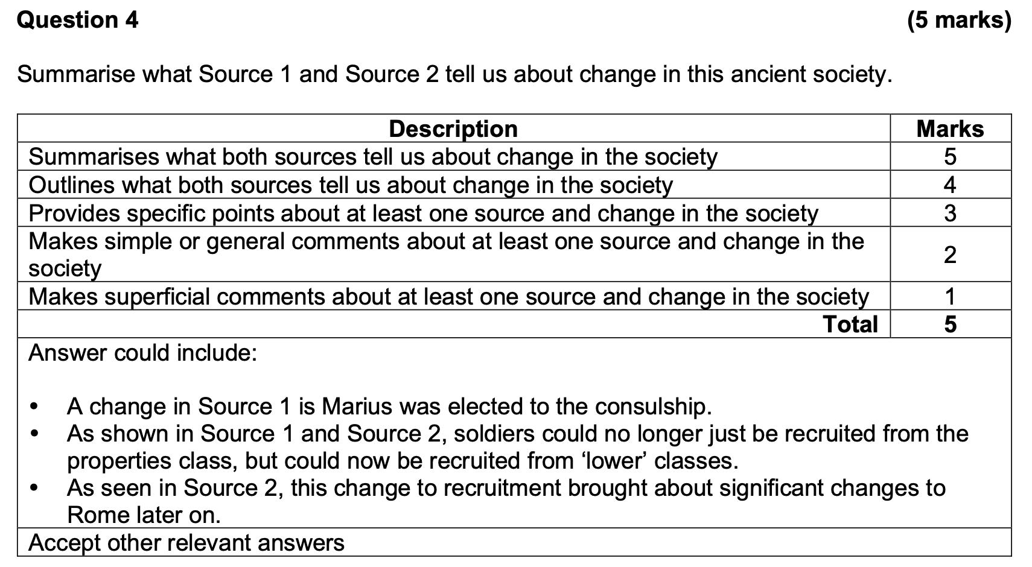
Question 4

Slide 10
Reflect on this response
A change in Source 1 is Marius was elected to the consulship.
As shown in Source 1 and Source 2, soldiers could no longer just be recruited from the properties class, but could now be recruited from ‘lower’ classes.
As seen in Source 2, this change to recruitment brought about significant changes to Rome later on.

Slide 11
Practice Source Analysis
Complete the Source Analysis (10 minutes)
We will mark this together as a class

